Slide 1
Going to the doctor at the Freeman Center

Slide 2
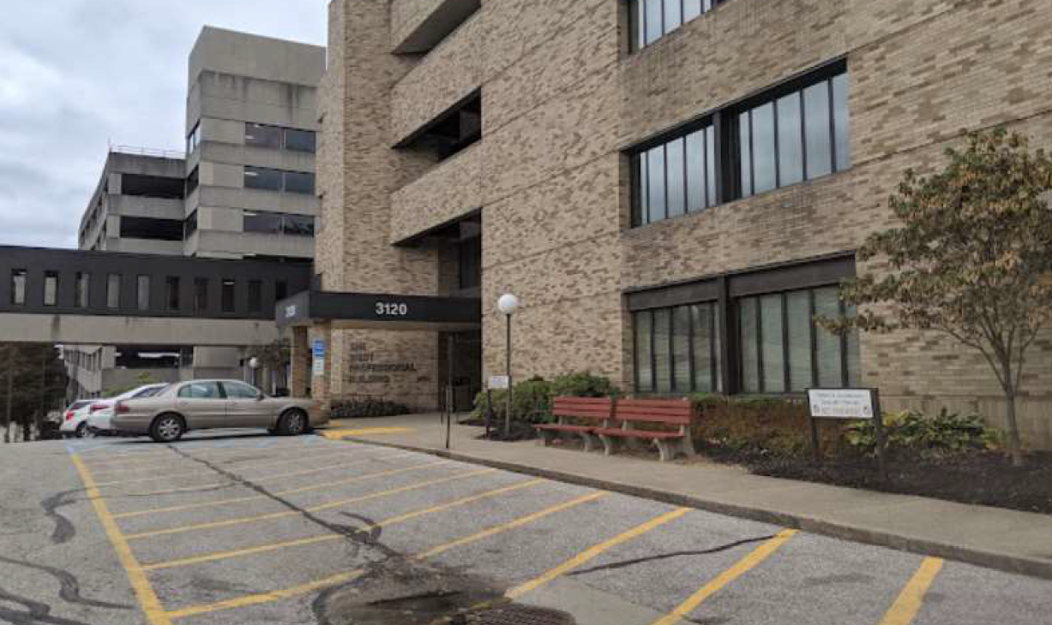
Sometimes, I might have to go to the doctor. The doctor is going to check my body and make sure I am healthy and strong.
I will go to the University of Cincinnati Hospital to the Freeman Center to see my doctor.

Slide 3
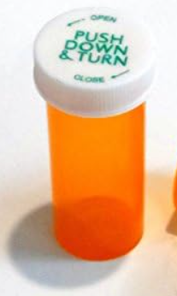

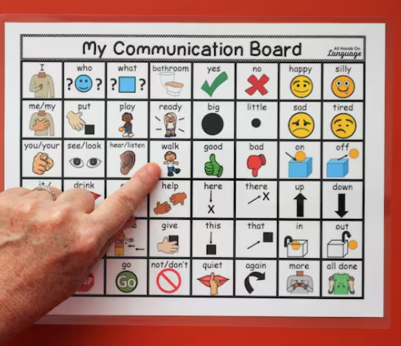
Before I leave my house, I need to make sure that I pack all of the things that I need. I may need to bring:
A list of my medications
Something to do while I wait
Supports to help me communicate with the doctor

Slide 4
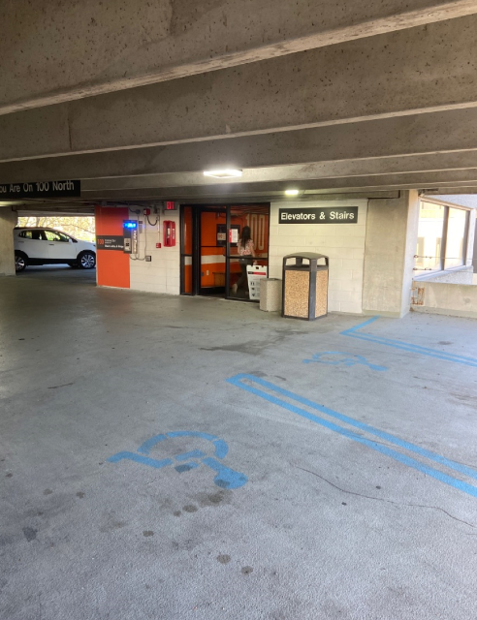
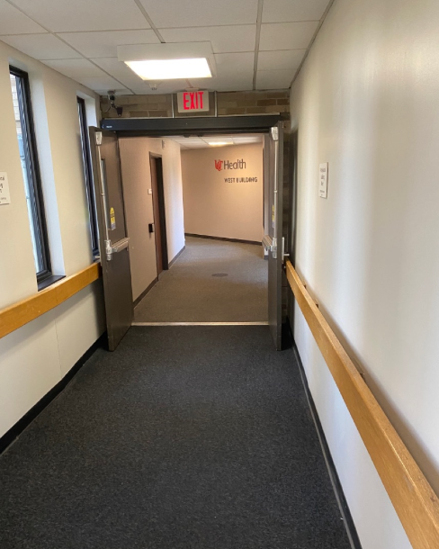
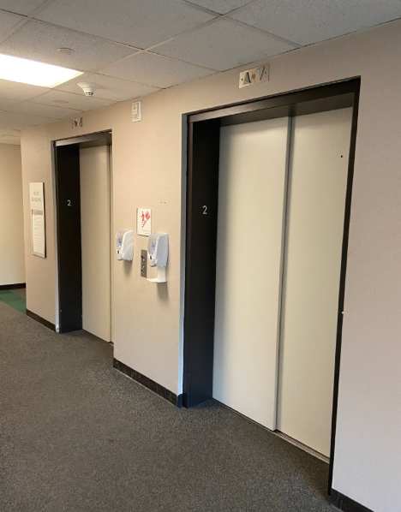
The Freeman Center is in a big building.
First, we will need to park the car in the parking garage.
Then, we will need to use the bridge on the 2nd floor to take me to the elevator
1
2
3

Slide 5
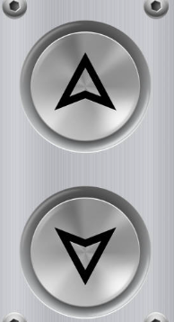
When I get to the elevator, I will push the Up Arrow button.

Slide 6
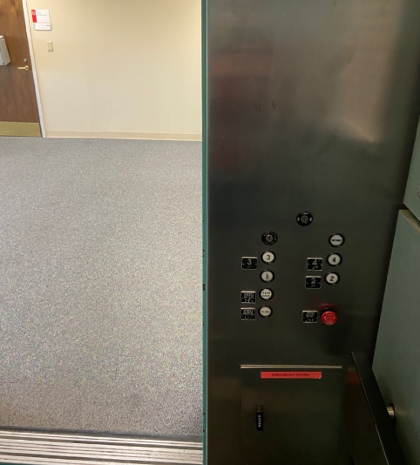
The Freeman Center office is on the 4th floor. I will push the 4 button when I get in the elevator.

Slide 7
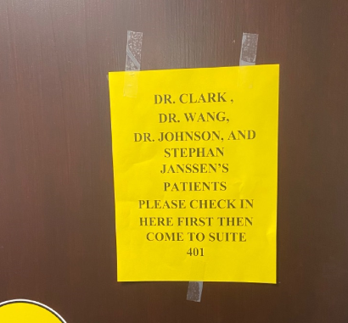
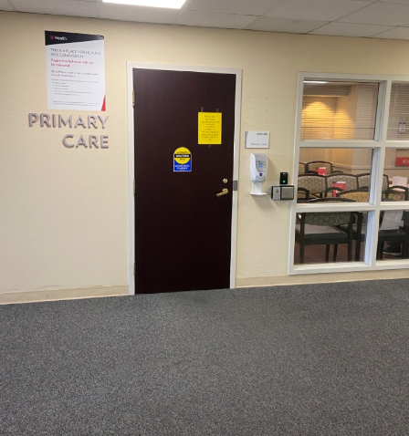
When I get to the 4th floor, I will check in at the front desk.
I need to check in at this desk first.

Slide 8

When I check in for the doctor, the nurse may ask me my name, my birthdate and if my body has been feeling well or sick lately.
If I need help in answering questions, I can ask a caregiver to come with me for extra support.
After I’m all checked in, it is time for me to go to the Freeman Center Waiting Room. The check in staff will tell me where to go.

Slide 9
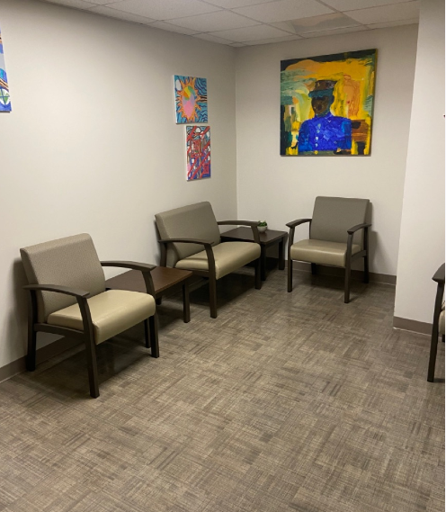
Now that I’m all checked in, I will sit in the waiting room until the nurse says we are ready to go to the exam room.

Slide 10
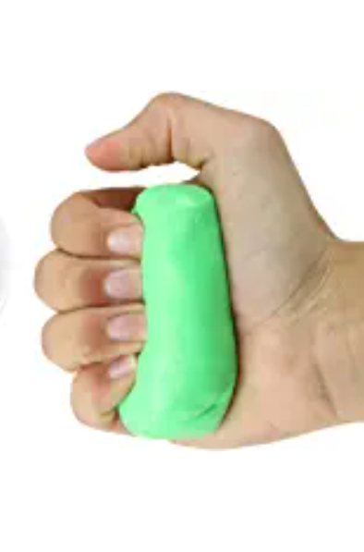
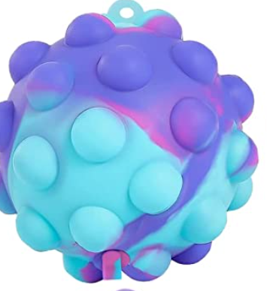


Sometimes, waiting can be hard. I can bring something from home to do or I can ask for something to do while I wait.
I can ask to:
Use fidgets
Color or use putty
Play a game or do a puzzle

Slide 11
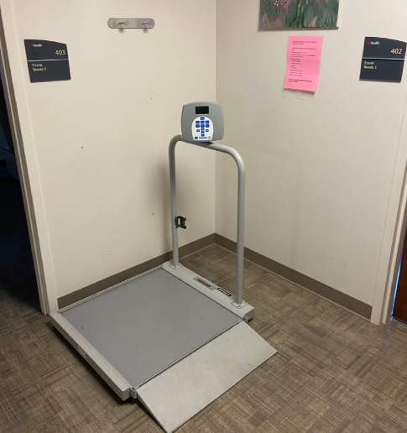
When it is my turn, the nurse will call my name and I will go to the exam room.
The nurse will ask me to stand on the scale to measure my weight. I can choose whether I leave my shoes on or take my shoes off.

Slide 12
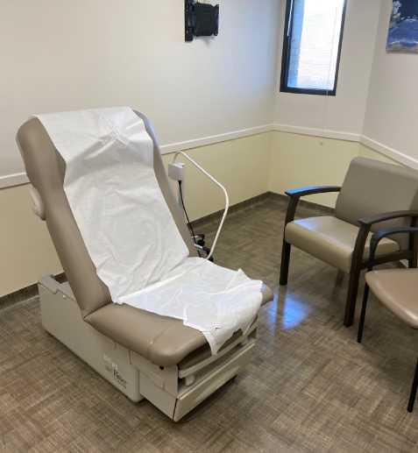
I will then go sit in the exam room and wait for the doctor.
The nurse may ask me some more questions about what medications I take and if I have been feeling okay.
My caregiver can help me answer questions, if I need help.

Slide 13
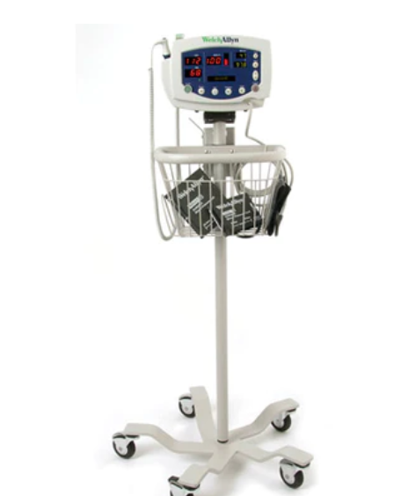
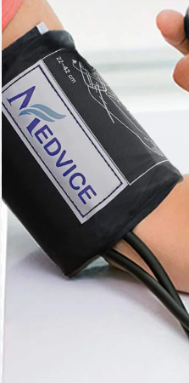
The nurse might put a soft bracelet around my arm to check if I am healthy.
When the soft bracelet is around my arm, the machine will pump air into the bracelet. I may feel some tightness around my arm. It will not be for long and it might feel tight.
When the soft bracelet is being used, I can ask my mom to hold my hand, squeeze a fidget ball or listen to music.

Slide 14
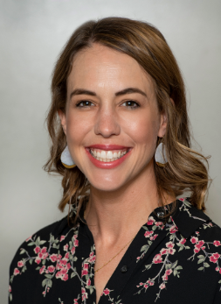
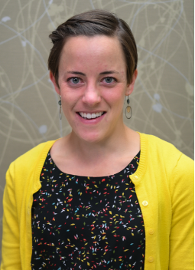
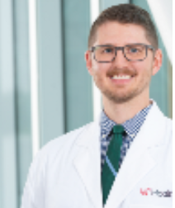
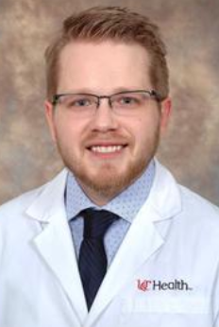
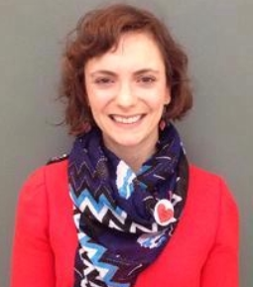
Next, the nurse will leave, and I will wait to see my doctor. The doctors at the Freeman Center are:
Dr. Wang Dr. Johnson Stephen Jannsen Dr. Keeton Dr. Rivendale
I can check on MyChart or my team will help me know what doctor I’m meeting today. I can also learn more about my doctors on the Freeman Center website.

Slide 15
Now that I have completed my check in for the Freeman Center, I can meet with my doctor so that I can stay healthy and safe.

