Slide 1
Joy In Work: Is It Possible?
Jennifer Rose V. Molano, MD
Associate Professor
The University of Cincinnati College of Medicine
Chair, UC-COM Faculty Wellness Advisory Council
18 December 2019

Slide 2
Learning Objectives
Summarize different definitions of work
Discuss barriers in finding joy in work
Brainstorm ways to increase joy in work

Slide 3
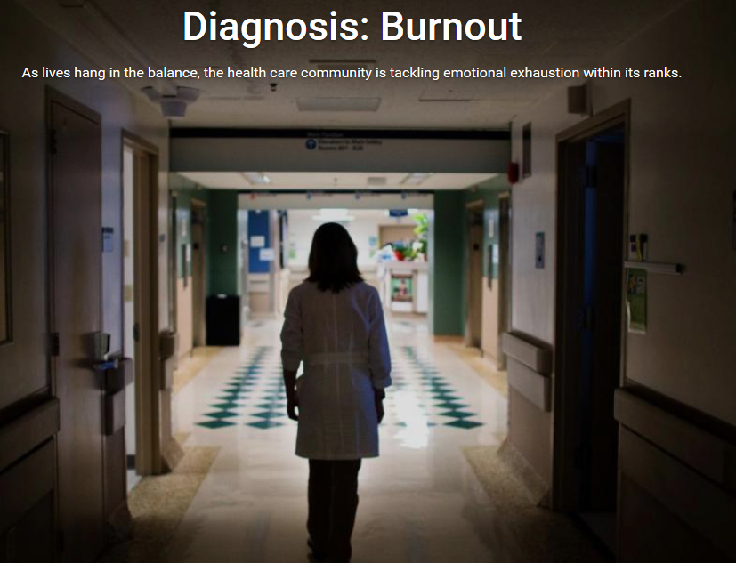
Why Talk About Joy In Work?
US News and World Reports

Slide 4
What IS burnout?
“Burnout is a response to chronic stressors that wear on a person over time – not acute ones such as a big event or a big change”
(Christina Maslach,PhD)
Emotional exhaustion
Depersonalization/loss of identity or self
Low sense of personal accomplishment

Slide 5
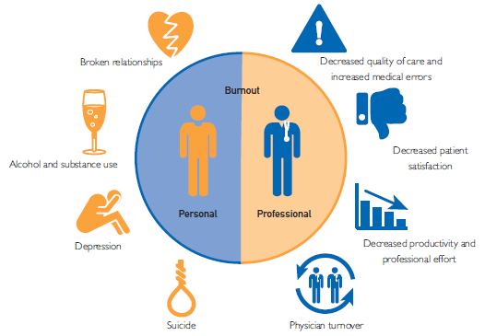
Consequences of Burnout
Shanafelt, Mayo Clinic Proceedings 2016

Slide 6
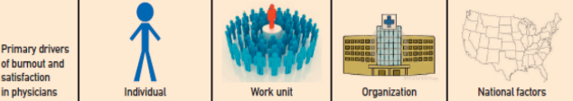
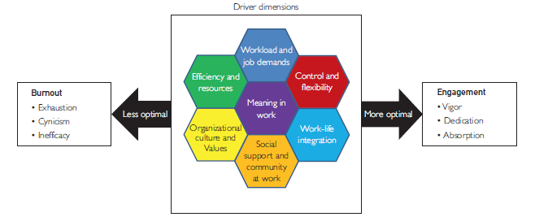
Shanafelt, Mayo Clinic Proceedings 2016
Maslach, World Psychiatry 2016

Slide 7
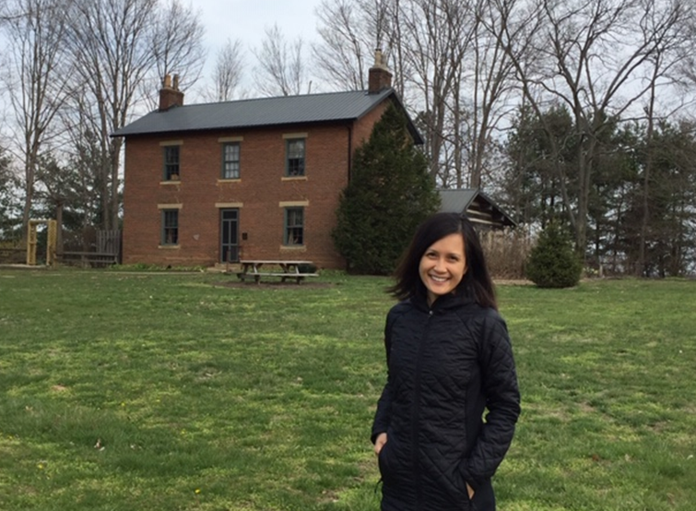
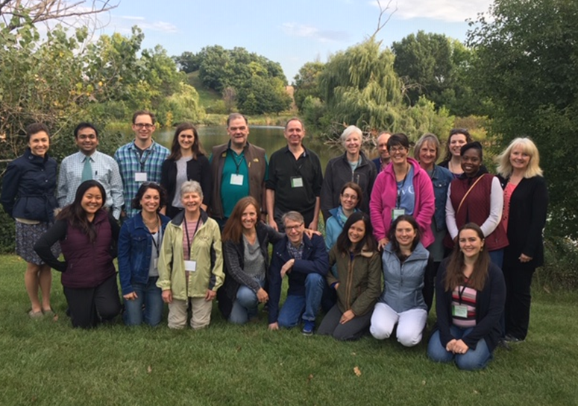
My Story

Slide 8
UC-COM Faculty Well-Being Advisory Council
Vision: To be a culture that promotes meaningful work and personal wellbeing
Mission: To empower our community to engage in meaningful work and personal well-being
W
Purpose
Environment
Camaraderie/
Community
Security/
Support
Health
Control/
Autonomy
- Adapted from the Institute of Healthcare Improvement Joy in Work Framework
and the University of Minnesota Model of Wellbeing

Slide 9
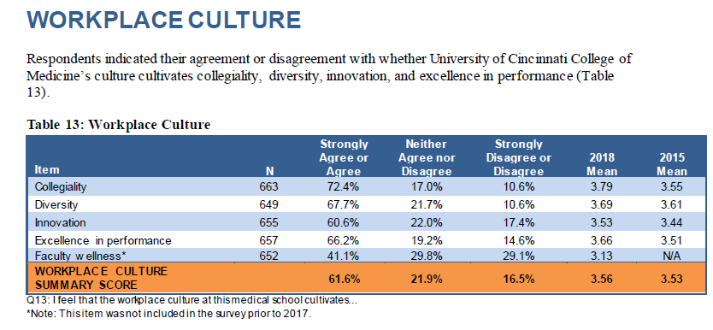
Why Should We Cultivate Joy In Work In Our Workplace?
UC-COM Faculty AAMC Stand Point Survey 2018 Responses

Slide 10
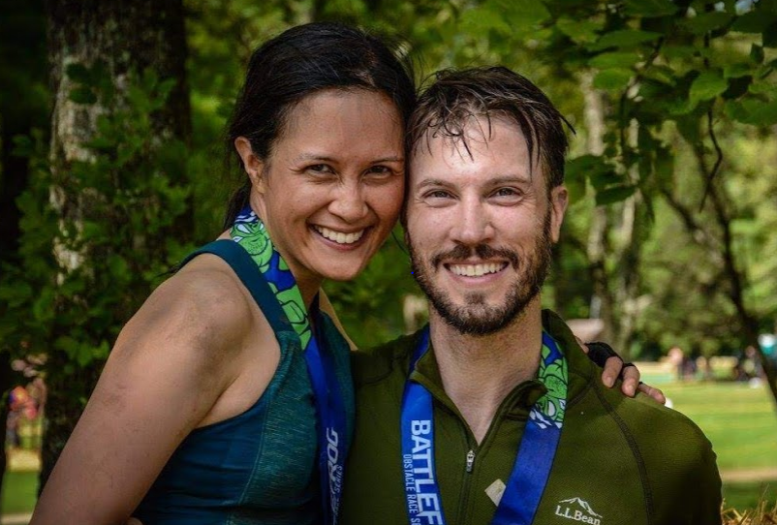
The Quest

Slide 11


Joy and Meaning in Work
The Importance of Mindset
Mindset is the lens through which one sees the world.

Slide 12
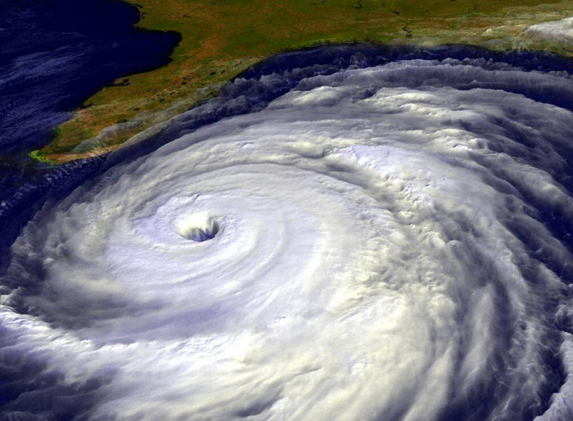

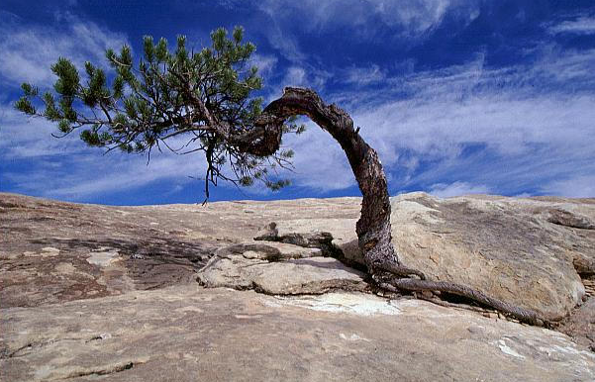
Joy and Meaning in Work
The Importance of Mindset
MINDSET → BEHAVIORS → RESULTS

Slide 13
What Is Work?
“Activity involving mental or physical effort done in order to achieve a purpose or result.”
Lexico.com

Slide 14
Types of Work
Deep Work
Valuable
Shallow Work
Non-cognitively demanding
Meaningful
Logistical-style tasks
Deep Work by Cal Newport

Slide 15
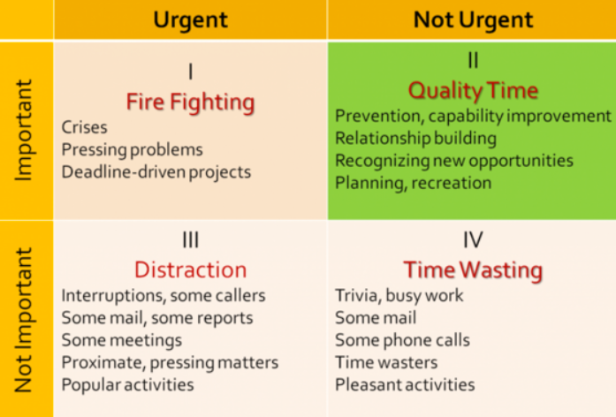
Types of Work
https://www.huffpost.com/entry/what-stephen-covey-taught_b_12458334

Slide 16
Types of Work in Academic Medicine
Patient Care
Research
Education
Administration
Other
Shanafelt et al, Arch Intern Med. 2009;169(10):990-995

Slide 17
What Brings You Joy?
Places
People
Joy
Activities
Objects
Joyful, Ingrid Fetell Lee

Slide 18
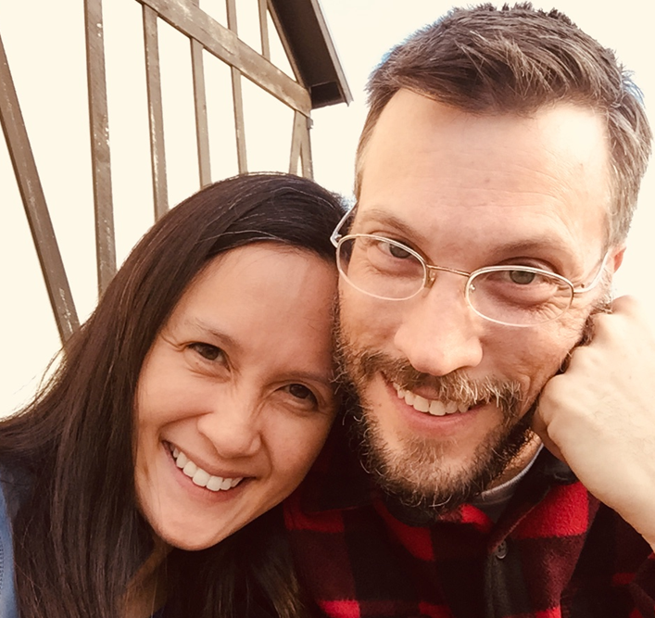
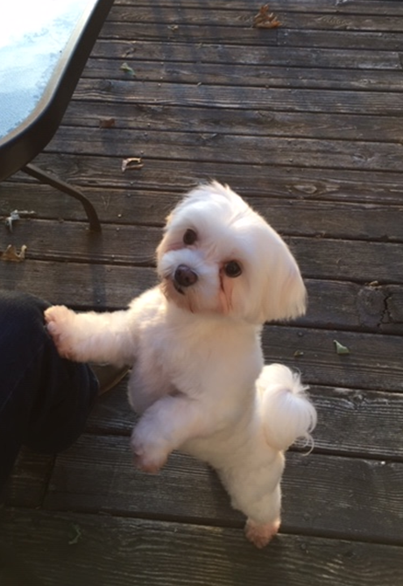
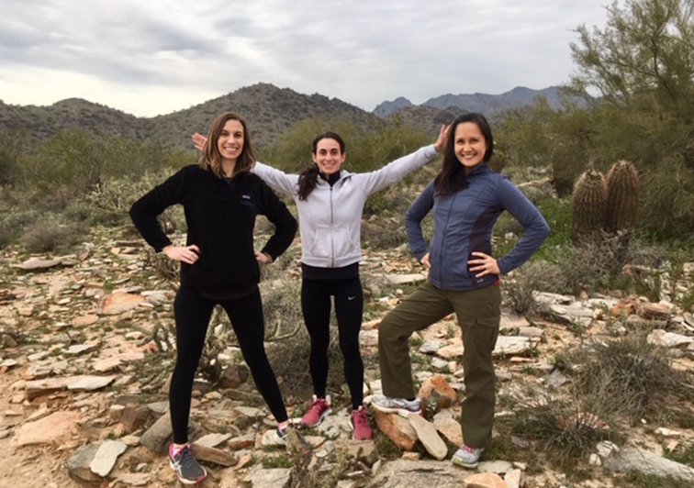
What Brings You Joy?

Slide 19
What is Joy?
“A feeling of great pleasure or happiness”
Lexico.com

Slide 20
Evocations of Joy
Abundance
Renewal
Harmony
Magic
Joy
Surprise
Energy
Celebration
Play
Freedom
Transcendence
Joyful, Ingrid Fetell Lee

Slide 21
What Brings You Joy At Work?
Joy
Work

Slide 22
Self-Reflection Exercise
Remember a time when you left work with joy and pride
What was that experience?
What in the environment and circumstances made that experience possible?
How did you contribute to this situation?
How did others contribute to this experience?
How did this experience serve your purpose in life and in work?
How can you and your colleagues continue to maintain this level of joy and pride in your work?

Slide 23
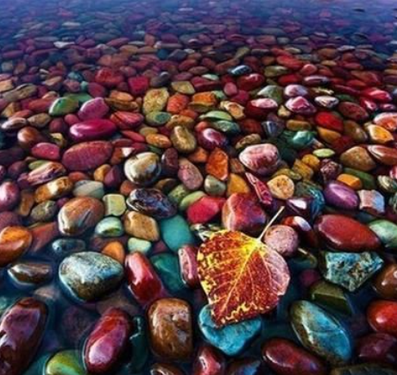
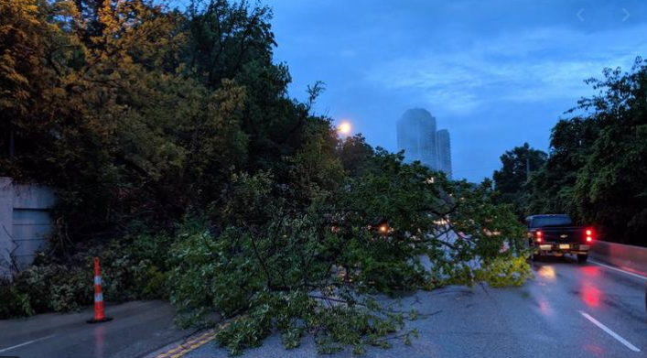
What Are Your Biggest Barriers to Joy in Work?
Pinterest.com
Bizjournals.com

Slide 24
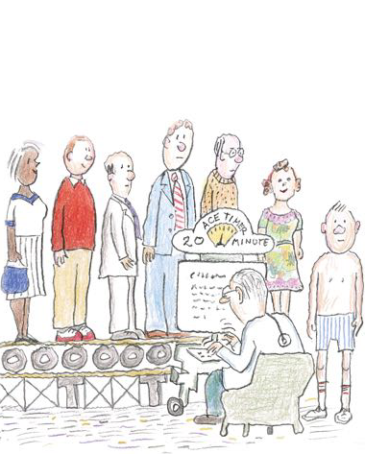
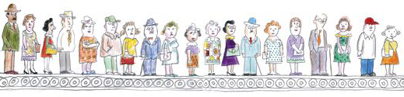
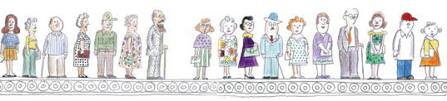
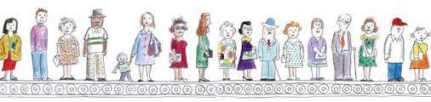
What Are Your Biggest Barriers to Joy in Work?
Pharos, Spring 2016 Issue

Slide 25
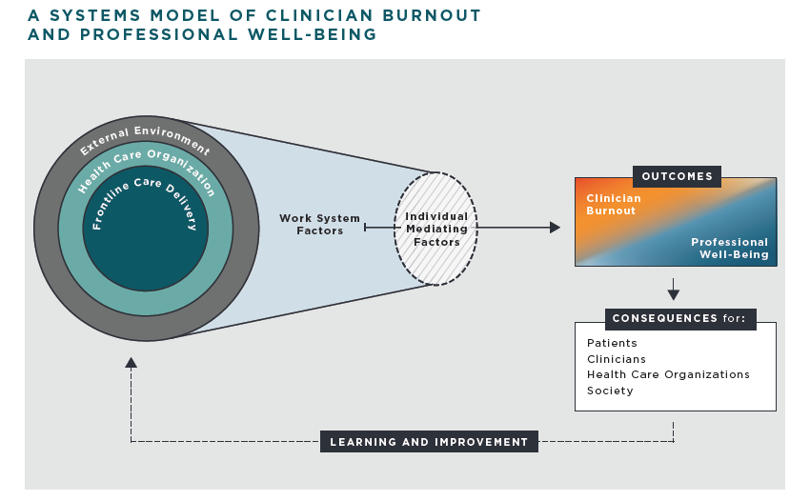
Joy In Work:
The Work and Learning Environment Matter
National Academy of Medicine (NAM) Action Collaborative: Goals for Clinician Wellbeing

Slide 26
Joy In Work
NAM Goals for Clinician Wellbeing
Create positive work environments
Create positive learning environments
Reduce administrative burden
Enable technology solutions
Provide support to clinicians and learners
Invest in research
Goals may also align with priorities for basic scientists.

Slide 27

How Can We Find Joy In Work?
WordPress.com

Slide 28
How Can We Find Joy In Work?
Finding Our Purpose
Purpose is active and may change over time.
Values include our passions, beliefs and joys.
Goals implies action and direction.
PURPOSE = VALUES + GOALS
St. John B and Haines A. Micro-Resilience, 2017

Slide 29
How Can We Find Joy In Work?
Finding Our Purpose
Doing work that fulfills our purpose can bring joy and meaning to our work.
PURPOSE
WORK
St. John B and Haines A. Micro-Resilience, 2017

Slide 30
Questions
What do you value in your work?
What makes you feel valued at work?

Slide 31
Types of Work in Academic Medicine
Patient Care
Research
Education
Administration
Other
20%
Shanafelt et al, Arch Intern Med. 2009;169(10):990-995

Slide 32
How Else Can We Find Joy In Work?
Places
People
Joy
Activities
Objects
Joyful, Ingrid Fetell Lee

Slide 33
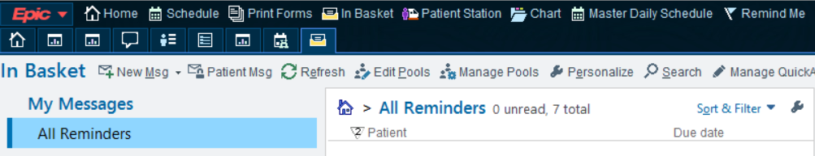


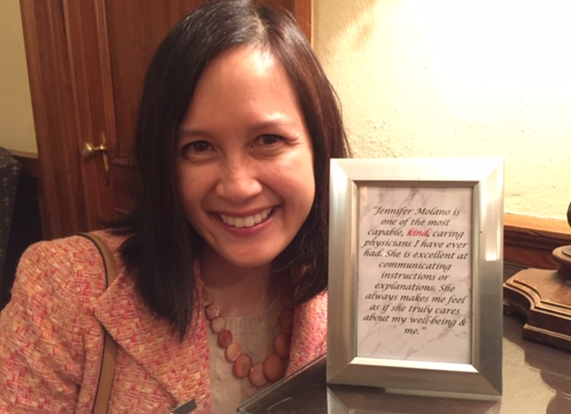
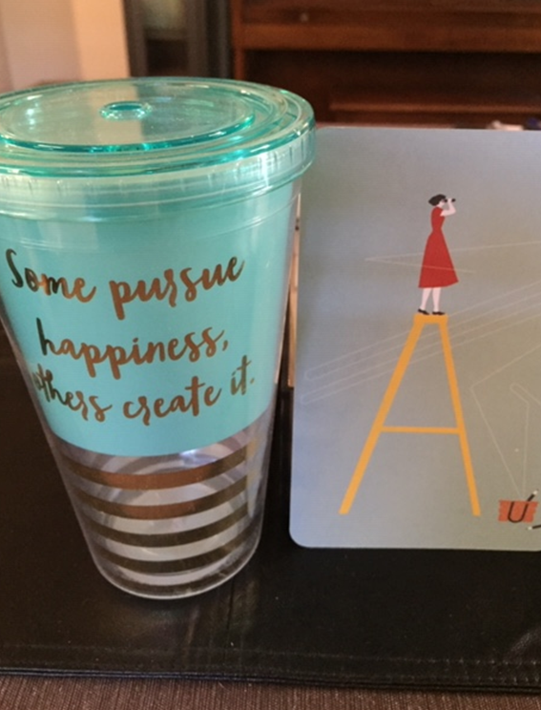
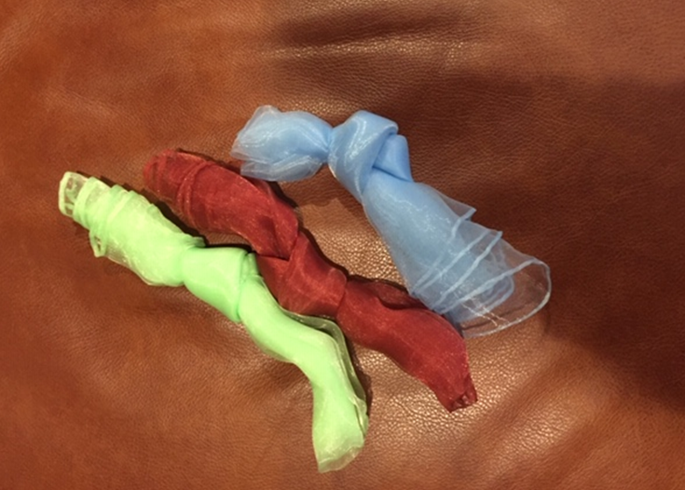
My Joy Kit

Slide 34
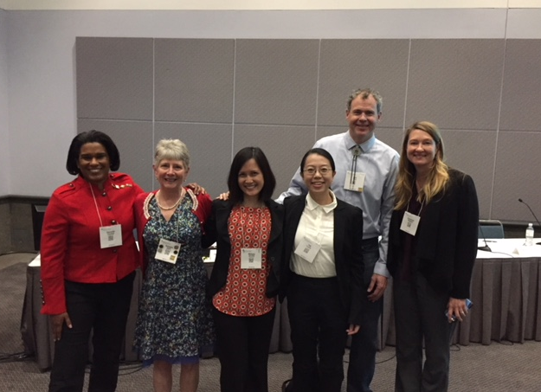
How Can We Find Joy In Work?
“Joy Rounds” – Idea by Kim Hutchison, MD (Oregon Health Sciences University) from the 2018 “Being a Resilient Leader” AAN Annual Meeting Course
“What has brought you joy today?”

Slide 35
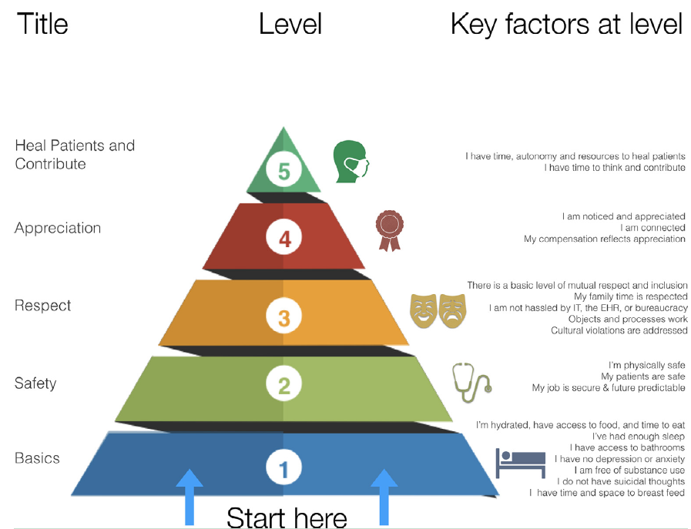
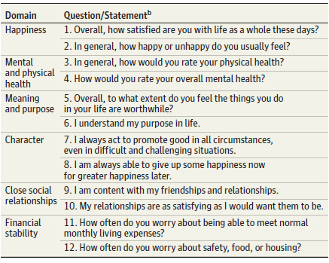
Finding Joy and Meaning in Work
Flourishing and Professional Wellness
Flourishing
The Health Professional Wellness Hierarchy
Vanderweele TJ, JAMA, 2019
Shapiro DE, Am J Medicine, 2019

Slide 36
Learning Objectives
Summarize different definitions of work
Discuss barriers in finding joy in work
Brainstorm ways to increase joy in work

Slide 37
Moving Forward …
Think about what matters to you.
Finding joy is a practice.
Ask yourself, “What is one thing you can do today – no matter how small – that can bring you or someone else joy?”
Kelm: The Joy of Appreciative Living

Slide 38

What Do You Value Most At This Institution?
UC-COM AAMC Stand Point Survey Responses

Slide 39
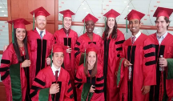

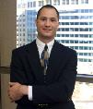

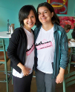
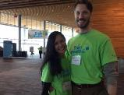
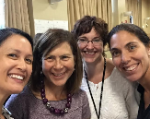
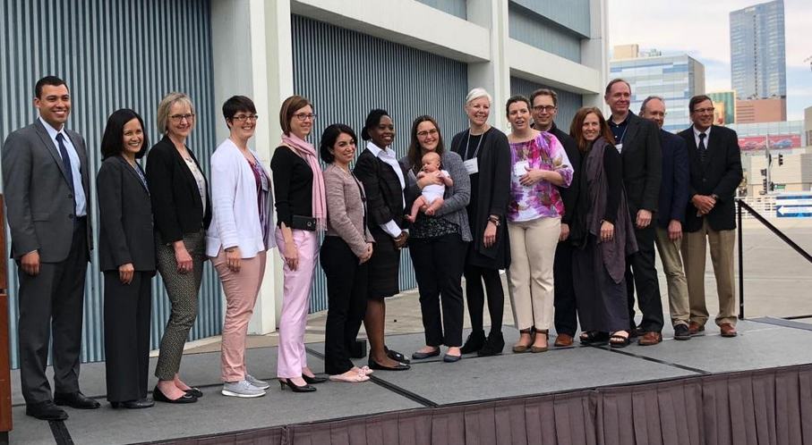
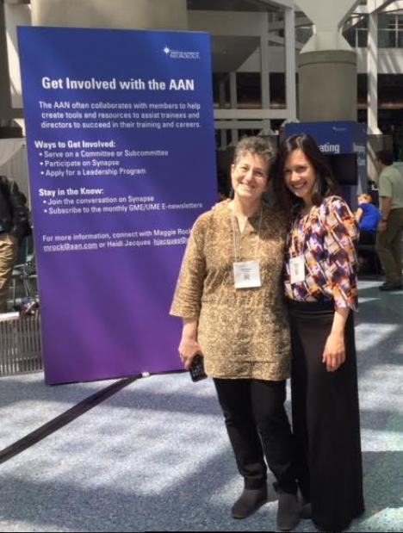
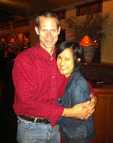
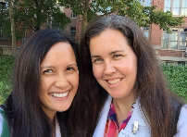
Thank you
PLUS:
All of my patients
All of the clinic support staff and managers
All of the sleep lab techs
All of the nurses, CNPs, PAs, residents and fellows
Administrative assistants:
Angela Schoner
Lori Selm
Misty Wethington
Maggie Baker
And many, many more …

Slide 40
Abundance
Renewal
Harmony
Magic
Joy
Surprise
Energy
Celebration
Play
Freedom
Transcendence
Joyful, Ingrid Fetell Lee

