Slide 1

NIH Grant Writing
Frank McCormack
Taylor Professor and Director
Division of Pulmonary, Critical Care and Sleep Medicine
University of Cincinnati
January 14, 2020

Slide 2
Outline
Editorial
Why a Science Career?
Types of NIH Grants/Institutes/Grant Cycles
New NIH Format
Writing the Grant
How the Grant is Reviewed
Helpful Resources

Slide 3
Since 2003, the College of Medicine has fallen from the 41st in NIH funding to 62nd (of 147), while regional academic peers have held their own or improved
UL
UK
UC
OSU
IU

Slide 4

Success in science by academic health centers requires:
  an ‘all in’ commitment
  strategic planning
  enlightened leadership
  tolerance for risk
  aggressive investment

Slide 5

‘All in commitment’ means we need to do more than support the investigators who are here, we need a strategic plan for recruitment and retention that replaces mentors and attracts young talent
Attrition
Recruitment
Departures

Slide 6
Experience that qualifies me to give this talk
30 years of research funding and grant writing
Prior service on NIH, ATS, ALA, DOD, VA, LAM, CCTST, Foundation study sections
Current service on NHLBI study section
I have made every mistake there is to make

Slide 7
The good news:
A successful career in science is ‘As Good as It Gets’
You work for yourself
Your have the privilege of meeting & working with intelligent, accomplished, inspiring people
Your work is challenging and constantly changing, never boring
Your work has meaning and purpose
Your may enjoy the respect and admiration of peers
You may travel the world
There is nothing more rewarding than setting a goal and assembling a team to reach it
You have the potential to do something that matters
You can realize a level of fulfilment that is not typical in business or other careers

Slide 8
The bad news:
It is going to hurt
There will be investigational dry spells and failures
There will harsh critiques
There will be rejection
There will be serial resubmission
There will be funding hiatuses
There will be expansions and contractions in your group

Slide 9
Requirements
A successful career in science
You have to love it and want it in the worst way
You have to be prepared to make sacrifices
You must have a high tolerance for frustration
You must build a track record of productivity
You must build relationships with peers in your field
You should not get distracted by shiny new technologies, unless they are needed to answer the question
Remember that the primary objective is to have an impact, and not to write papers or get funded or get promoted

Slide 10
Recommendations:
A successful career in science
Find a mentor with the capacity to be professionally generous and promote you selflessly
Ask questions that matter
Be patient, persistent, resilient
Be generous with reagents, models, ideas
Collaborate widely
Find group members that not only help you but extend you
Diversify-don’t put all eggs in one basket
  Our group has grants for trials and grants for laboratory work and grants that encompass both
  Our group has small amounts of support on other grants.

Slide 11

The most important recommendation for a career in science:
Be persistent
Nothing in this world can take the place of persistence. Talent will not: nothing is more common than unsuccessful men with talent. Genius will not; unrewarded genius is almost a proverb. Education will not: the world is full of educated derelicts. Persistence and determination alone are omnipotent.
Calvin Coolidge

Slide 12
Our last two RO1’s
Alveolar microlithiasis grant
RO1 submission #2 June 2014 6th percentile
Influenza grant
VA Merit submission #1 Jan 2015 58.9th percentile
VA Merit submission #2 June 2015 58.5th percentile
VA Merit submission #3 March 2017 33.3th percentile
RO1 submission #1 Feb 2016 Triaged
RO1 submission #2 March 2017 5th percentile

Slide 13
Grants submitted by Arun Jose, MD
IMSTAR Fellow, hired summer 2018
UC CCTST KL-2 (8/2018) – Declined LOI
Chest 2018 Travel Grant (8/2018) – Awarded
UC Junior Faculty Pilot (11/2018) – not awarded
SRC CReFF Junior Faculty Pilot Program (11/2018) – Awarded
ARS Trainee Grant (12/2018) – not awarded
Entelligence Young Investigator (2/2019) – not awarded
VA CDA-2 (4/2019) – Declined LOI
CHEST Foundation PAH Grant (4/2019) – not awarded
UC Rehn Research Grant (5/2019) – not awarded
DOIM Travel Grant (5/2019) – not awarded
Team PH Research Grant (5/2019) – not awarded
United Therapeutics Sponsored Study (5/2019) – Awarded
PHAB Bayer Young Investigator (7/2019) – Declined LOI
HLVI 2019 Post-Doctoral Travel Grant (10/2019) – Awarded
Parker B. Francis Foundation Award (10/2019) – under review
CCTST Just In Time Grant (10/2019) – not awarded
CCTST Pilot Mentored Translational Grant (11/2019) – Declined LOI
NIH K23 (11/2019) – under review
AHA Career Development Award (11/2019) – under review
NIH Loan Repayment Program (11/2019) – under review
UC HLVI Near Horizons Grant (12/2019) – under review
Oak Ridge Research University Fund (1/2020) – under review
VA CDA-2 (2/2020) – under review
Entelligence Young Investigator (2/2020) – under review
Also completed a Masters in Clinical and Translational Research and has 4 papers accepted for publication

Slide 14
What Grant Type? What Institute?
Step 1: Draft an abstract with Aims to get your thoughts together
Step 2: Choose an Institute and a funding mechanism
  Read their web pages to learn about THEIR priorities
  Decide how your work fits/enhances their research agenda/portfolio
Step 3: Call the Program Officer
  Job = advocate for researchers, demystify process
  Will help you with “fit” – how your work aligns with Institute mission

Slide 15
27 Institutes/Centers + Director’s Office
NCI Cancer | NIAMS Arthritis & Musculoskeletal/ Skin | NIEHS Environmental Health | NCCAM Complementary & Alternative Medicine
NEI Eye | NIBIB Biomed Imaging & Bioeng. | NIGMS General Medical Sciences | NCATS Advancing Translational Science
NHLBI Heart, Lung, Blood | NICHD Child Health & Development | NIMH Mental Health | CIT Information Technology
NHGRI Genome | NIDCD Deafness & Comm Disorders | NIMHD Minority Health/Disparities | CSR Scientific Review
NIA Aging | NIDCR Dental & Craniofacial Research | NINDS Neuro & Stroke | FIC Fogarty Int’l Center
NIAAA Alcohol | NIDDK Diabetes, Digestive & Kidney | NINR Nursing Research | CC Clinical Center
NIAID Allergy/ Infectious Disease | NIDA Drug Abuse | NLM Library of Medicine | OD Office of the Director

Slide 16
Grant Cycles – Standard Dates
http://grants.nih.gov/grants/funding/submissionschedule.htm
Activity | Cycle I-Winter | Cycle II-Spring | Cycle III-Fall
Due Dates: R01 K R03/R21 | February 5 February 12 February 16 | June 5 June 12 June 16 | October 5 October 12 October 16
Scientific Merit Review | June – July | October – November | February - March
Advisory Council Round | August or October | January | May
Earliest Start Date | September or December | April | July

Slide 17
NIH Funding Mechanisms
F = Fellowships (pre- & post-doc)
K = Career Development Awards
T = Training Grants (https://researchtraining.nih.gov)
R = Research Projects
P = Program Project/Center Grants
U = Cooperative Agreements Grants

Slide 18
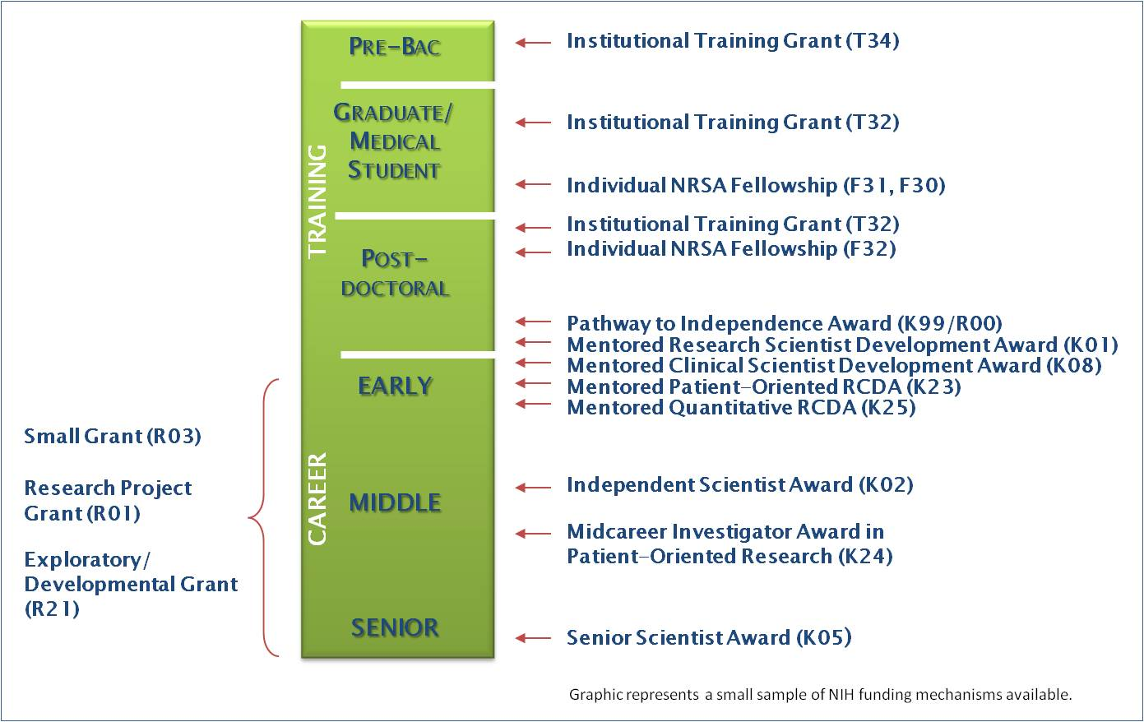
Career Development Awards
http://nexus.od.nih.gov/all/2011/10/07/trends-in-nih-training-and-career-development-awards/

Slide 19
NIH TRAINING GRANTS FOR CLINICIANS
https://researchtraining.nih.gov/career/postdoctoral-residency

Slide 20
TRAINING GRANTS FOR PHDS
FELLOWSHIPS
F05 | International Research Fellowships
F30 | Ruth L. Kirschstein Individual Predoctoral NRSA for MD/​PhD and other Dual Degree Fellowships
F31 | Ruth L. Kirschstein Predoctoral Individual National Research Service Award
F32 | Ruth L. Kirschstein Postdoctoral Individual National Research Service Award
F33 | Ruth L. Kirschstein National Research Service Awards for Senior Fellows
F99/K00 | Individual Predoctoral to Postdoctoral Fellow Transition Award
https://researchtraining.nih.gov/programs/fellowships

Slide 21
What does it take to be K-competitive?
Demonstration of commitment to research
  At least 1-2 first author publications (more is better!)
Evidence of strong mentor-mentee relationship
Clear, compelling training plan to show how you will develop research skills-(K’s rise and fall on this)
Solid project
Prepare well
  Review successful grants, talk to mentors who have sat on K study sections (Patel, McGraw, etc)

Slide 22
KO1
Mentored Research Scientist Career Development Award
provides support and protected time for an intensive, supervised career development experience in the biomedical, behavioral, or clinical sciences leading to research independence.
some NIH Institutes use the K01 to enhance workforce diversity, to train in a new field or after a hiatus in their research career.

Slide 23
KO8
Mentored Clinical Scientist Research Career Development Award
to prepare clinically trained individuals for careers that have a significant impact on the health-related research needs of the Nation.
provides support and protected time for an intensive, supervised research career development experience in the fields of biomedical, behavioral, or clinical research, including translational research.

Slide 24
K23
Mentored Patient-Oriented Research Career Development Award
to support the career development of individuals with a clinical doctoral degree, who have the potential to develop into productive, clinical investigators, and who have made a commitment to focus their research endeavors on patient-oriented research.

Slide 25
F32
Ruth L. Kirschstein Postdoctoral Individual National Research Service Award
to enhance the research training of promising postdoctoral candidates who have the potential to become productive, independent investigators in scientific health-related research fields

Slide 26
K99/R00 and K99/F00
Pathway to Independence Award
to increase and maintain a strong cohort of new and talented, NIH-supported, independent investigators.
to facilitate timely transition of outstanding postdoctoral researchers or clinician-scientists from mentored research positions to a)independent, tenure-track or equivalent faculty positions, or b)post doc positions (K99/F00)
to provide independent NIH research support during the transition to help launch competitive, independent research careers.

Slide 27
Research Grants: R03
Small grants – Scope includes:
  Pilot/feasibility studies
  Secondary analyses
  Development of research methodology or technology
Maximum time = 2 years
Maximum budget = $100,000 ($50K/yr)
No preliminary data requirement

Slide 28
Research Grants: R21
Focus on exploratory/developmental work
  Novel/innovative/riskier ideas
  Extend previous work in new directions
Maximum time = 2 years
Maximum budget = $275,000 (no more than $200K in a single yr)
No preliminary data requirement

Slide 29
Research Grants: R01
Research project grant
  Broad range of projects
Maximum time = 5 years, some eligible for competitive renewal
  Many argue for smaller first project (3 yr)
Maximum budget = no specified limit
  Modular budget = $250K direct per module
  Defined budget= have to ask for permission if over $500K per year

Slide 30
Grants manager
Recommendation
We have a person who helps us with all of aspects of grants
  Identifies funding mechanisms
  Helps assemble proposals
    Other support
    Biosketches
    Resources and environment
    Budget
    All other little bits
  Interactions with the sponsored program office and IRBs
  Progress reports, letters, sometimes drafts of science for some disciplines
Allows you to focus on the science
We have tripled the number of grants submitted by our division
With her help, our group has obtained 2 RO1, 2UO1, 1R34, multiple Foundation, Association and other grants
Her salary has been covered by writing her in as a coordinator on multiple grants.
The Academic Research Service within the Dept of Medicine now provides this service for other divisions (Eric Smith, and others)

Slide 31
New NIH Format
Greater emphasis on
  Quality of content (less on detailed description of what will be done)
  Funding New/Early stage investigators
Shortening the research plan
  Elimination of sections for literature review and presentation of preliminary data
9-point evaluation scale
Standardization and shortening of reviews
Linkage of sections of the application to each of the 5 core review criteria

Slide 32
New Sections Template
Specific Aims (1 page)
Research Strategy (12 pages for most)
  Significance
  Innovation
  Approach
Timetable

Slide 33
For training grants
Plan ahead
  6 months pilot work + research question
  6 months writing the grant
  Involve mentor / co-investigators with warning
Form a mentorship committee that meets at least quarterly, more often close to submission
Write and revise a 1-2 pg concept paper
  Share ahead of every meeting
  Revise between meetings
  This will become Specific Aims section . . .

Slide 34
Writing a successful grant
Read and emulate successful grants
  Repository of training grants here
Sit in on study sections as an observer (CCTST Apprenticeship Program-dennis.mcgraw@uc.edu)
If Training award – write Career Plan in parallel with Research Plan
  Involve mentor, co-investigator, biostatistician early (6-12 months)
Inouye SK, Ann Intern Med 2005

Slide 35

Writing Tips
Tell a story . . .
  Build your argument
  Help reviewers care
  Make it easy for them to find the rigor of the , rigor/transparency, sex as a variable, significance and innovation. (.e.g. This project is innovative because…)
Punctuate key points
  Write the Aims first….and Last.
  Use subheadings (underline/bold)
Use a conceptual framework and model
  Use diagrams!-effect or temporal relations
  Make the link between aims and products clear

Slide 36
Writing a successful grant
Ask questions that matter
Have great ideas for how to answer them
Start early
Tell an epic story
Use words parsimoniously, stay on theme
  Avoid repetition and superlatives. Be understated.
Avoid temptation to show all your data so that others feel your pain. Clarity it the goal.
Develop an iterative relationship with a mentor or co-investigator to improve the grant through many, many, many cycles of editing and revision
Have senior people outside your area read your grant, or at least the specific aims page.

Slide 37
It’s the idea
Its not the quality of the prose (although it has to be great)
Its not fancy new technology (although it helps)
Its not molecular or statistical gymnastics (although that can impress)
and how you present it
Has to be a story that is clear and compelling
The reviewer greatly appreciates it if he learns from you
Especially if you are making connections he did not see in the past or you are giving him new insights
If you are genuinely excited, it comes through, and the grant writes itself (almost)

Slide 38
Specific aims page
This is the audition
If you don’t get this right, nothing else matters
Should be refined in dozens of iterations, preferably with mentor or valued colleague
Generally structured as
  Introductory paragraph-the need
  Second paragraph-the idea and plan
  The aims
  Pithy summary

Slide 39
Specific aims page
Introductory paragraph
  Introduce research subject
  What is known
    Influenza spreads across the globe in seasonal epidemics that cause between 3 and 5 million cases of severe illness every year, preferentially targeting the very young, the pregnant, smokers, the elderly and those with chronic cardiopulmonary disease.
  Gap in knowledge
  Critical need

Slide 40
Specific aims page
Second paragraph
  Introduce the solution
    What you are going to do?
    Why are you doing it?
    How will you do it?
  Long term goal
  Hypothesis and proposal objective
  Rationale
  Qualifications

Slide 41
Specific aims page
Aims
  Should be related and thematic but not interdependent
  One, two or three aims, 3-5 sentences each
  Aims should have an title that states an objective that relates to hypothesis
  Brief summary and expected outcomes
  Qualifications/resources that make if feasible

Slide 42
Specific aims
I like a formula for aims that looks like this
Aim #. The hypothesis to be tested is xxxx. We will use aaa approach to determine the mechanisms of bbb. We will determine ccc by method ddd. Method eee will be used to define fff. Successful completion of the aims of this grant will reveal the importance of ggg in hhh.

Slide 43
Significance
Describe how the project addresses an important problem or a critical barrier to progress in the field
Demonstrate the rigor of the prior research
Discuss how scientific knowledge, technical capability, and/or clinical practice will be improved.
Describe how successful completion of the aims will change the concepts, methods, technologies, treatments, services, or preventative interventions that drive the field under investigation?

Slide 44
Significance
Importance of the problem. In the Americas, the systemic dimorphic fungi account for > 1 million new infections annually, and Hc causes a significant proportion. The vast majority of cases of histoplasmosis in immunocompetent hosts are not severe, but ~ 10% of indi¬vid¬uals, especially those who are immunosuppressed, develop potentially life-threatening progressive disease (19). Yeast cells, the form that produces nearly all disease mani¬fest¬ations, are engulfed by professional phagocytes. Among these populations, Mo/M stand out because yeasts multiply intracellularly until these phagocytes are activated (20,21). Neutrophils (PMNs) and DCs inhibit growth spontaneously, but these cell population are less phagocytic than Mo/¬M which limits their effectiveness in Hc elimination (22,23) Our work has uncovered a previously undescribed role for Zn2+ and MTs in regulating the ability of GM-CSF- or IL-4-activated Mo/M to handle Hc. This effort has launched an area of investigation centered on the intersection of phagocyte biology, metallobiology, and nutri¬tional immunity. The current proposal will take the next leap forward and examine how metabo¬lism influences the MT-Zn2+ axis and Zn2+ transporters in Mo/Mand how the change affects cellular behavior upon invasion by Hc.
How rigorous is the prior research?
Prior literature from multiple laboratories nicely demonstrates that GM-CSF and IL-4 dictate disparate fates of Hc in Mo/Mf, and they rely on different MTs for their actions. These data provide a firm foundation for advancing our understanding the impact that the MT-Zn²⁺ axis exerts on Mo/Mf,
How will the project improve scientific knowledge? Our proposed studies will enlighten our understanding of the complex function of MTs, Zn²⁺, and Zn²⁺ transporters in Mo/Mf that are under assault by Hc. Knowledge gained from our proposal will include: 1) how glycolysis induced by GM-CSF governs MTs and Zn²⁺ transporters in infected Mo/Mf; 2) how MT3 dictates the glycolytic response associated with IL-4, and 3) how the MTs and Zn²⁺ exert a key function in anti-Hc defenses.
How will this work change the field? This work will have a far-reaching effect on the field of phagocyte interactions with Hc and as an extension to other intracellular pathogens. The envisioned studies will enhance knowledge regarding the role of MTs in innate immune defenses. The findings will create new opportunities to investigate the contribution of trace metals to phagocyte biology. From a translational point of view, being able to manipulate intracellular Zn²⁺ concentrations or expression of MTs may be one way to alter Mo/Mf function against invasion with an intracellular pathogen, like Hc. We expect our work to promote fresh studies regarding the action of MTs, Zn²⁺, and Zn transporters on Mo/Mf resistance to pathogenic microbes.

Slide 45
Rigor and Transparency
. 1. Is made up of 4 components
a. Rigor of prior research
b. Scientific rigor
Reproducibility, blinding, replicates, etc
c. Sex and other biological variables
d. Authentication of key biological/chemical resources
2. Download this pdf use it to be sure your grant complies
https://grants.nih.gov/grants/peer/guidelines_general/Reviewer_Guidance_on_Rigor_and_Transparency.pdf

Slide 46
Rigor of the prior research
The word ‘premise’ is now a third rail. Avoid it.
The applicant should discuss the quality and strength of the research being cited as crucial to support the application; this is distinct from the hypothesis or justification.
The applicant should describe how the proposed research will address weaknesses or gaps in prior research identified by the applicant. This may include the applicant’s own preliminary data, data published by the applicant, or data published by others. The NIH expects this consideration to include attention to the rigor of the previous experimental designs, as well as relevant biological variables and authentication of key resources.

Slide 47
Scientific Rigor
Scientific Rigor is the strict application of the scientific method to ensure robust and unbiased experimental design, methodology, analysis, interpretation and reporting of results. Whereas rigor of the prior research pertains to key supporting data, scientific rigor pertains to the proposed research.
The applicant should describe experimental controls, plans to reduce bias (blinding, randomization, inclusion and exclusion criteria, etc.), power analyses, and statistical methods, as appropriate.

Slide 48
Consideration of Sex and Other Biological Variables
Sex as a Biological Variable (SABV) should be factored into research designs, analyses, and reporting in vertebrate animal and human studies.
Consideration of SABV does not necessarily mean sex differences research.
A justification is expected if the application proposes to study one sex (e.g. a sex-specific condition or phenomenon)
“We will study both sexes” does not cut it and is a red flag
Cost and absence of known sex differences are inadequate justifications for not studying both sexes.

Slide 49
Example of scientific rigor and transparency statement in a grant
In this proposal, hypotheses will be tested employing previously established, reproducible, in vivo models. To ensure an unbiased approach, analyses of histology and immunostaining will be blinded, with viewing of multiple fields from at least five independent samples per group. All experiments will involve using 50% male and 50% female mice. Covariant analysis will be performed to assess any influence of gender. If data/trends suggest otherwise, comparisons of males and females will be formally pursued. We calculate we need at least x mice per time point so xx mice per group, y groups and yy mice per experiment. We will perform at least 3 experiments per model with each aa to determine zz. ……...
This statement nicely addresses rigor and sex as a biological variable. There is still a need to address the rigor of prior research in the research strategy

Slide 50
Authentication of Key Biological and/or Chemical Resources.
Key biological and/or chemical resources are those that 1) may differ from laboratory to laboratory or over time; 2) may have qualities and/or qualifications that could influence the research data; and 3) are integral to the proposed research. These include, but are not limited to, cell lines, specialty chemicals, antibodies, and other biologics, not standard laboratory reagents. Please see NOT-OD-17-068 for more details
Applicants should provide a brief plan (one page or less). The plan should not include authentication data or any other data. The plan may reflect existing guidelines or standards for authentication of a resource when such standards exist.

Slide 51

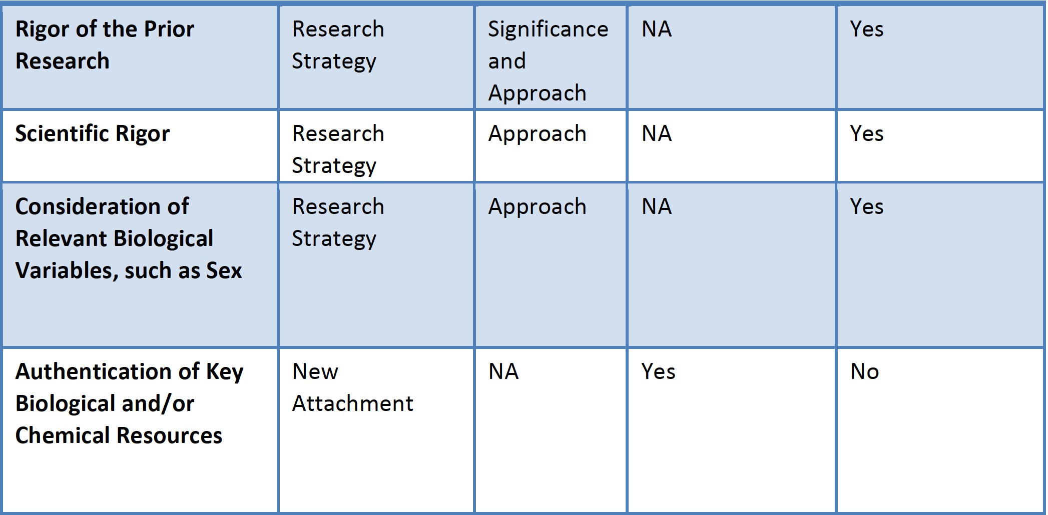

Slide 52
Innovation
The application challenges and seeks to shift current research or clinical practice paradigms by utilizing novel theoretical concepts, approaches or methodologies, instrumentation or interventions.
Not all applications need to be innovative to have a high impact on the field under investigation.
  The use of appropriate methodology that may not be innovative is not a weakness.

Slide 53
Innovation statement example
INNOVATION. Our proposal is conceptually innovative in that it analyzes the disparate regulatory functions of the MT-Zn²⁺ axis in cytokine-exposed Mo/Mf. We build on initial observations concerning the influence of MTs and Zn²⁺on the response by Mo/Mf to a stimulus that promotes killing of Hc (GM-CSF) and one that is permissive (IL-4). This proposal will: 1) uncover a new role for bioenergetics in regulating MTs and Zn²⁺in Mo/Mf ; 2) link changes in MTs as a result of metabolic preference to the antifungal activity of Mo/Mf, and 3) reveal an essential role for Zn²⁺ transporters and MTs in regulating phagosomal behavior of cytokine-stimulated Mo/Mf. We unite immunology, metabolism, analytical chemistry, and informatics to probe the in vitro and in vivo function of the trace metal Zn²⁺and MTs in host defenses to Hc. Execution of these experiments entails advanced cellular and molecular immunological strategies and cutting-edge analytical chemistry. Our focus will be on Mo/Mf because of their centrality in resistance to Hc. Interventions used to enhance the anti-Hc activity of these phagocytes will advance knowledge on how to boost host defenses to prevent immune col­lapse.

Slide 54
Approach
Provide a well reasoned overall strategy, methodology, and analyses, appropriate to accomplish the specific aims of the project.
Describe a robust and unbiased approach (scientific rigor), as appropriate for the work proposed, without exhaustive experimental detail
Discuss potential problems, alternative strategies, and benchmarks for success are presented.
Address sex (and perhaps age) as a biological variable
Plans for protection of human subjects from research risks, and inclusion of minorities and members of both sexes/genders, inclusion of children, need to be justified in terms of the scientific goals and research strategy proposed.

Slide 55
An exampe approach section
D. Does glycolysis control the distribution of macromolecular Zn2+ in Mo/M and Hc?
1. Hypothesis and Rationale. Our preliminary data indicate that 2-DG alters labile and macromolecular Zn2+. Therefore in this subaim, we will identify the Zn2+-binding proteins that are altered by inhibition of glycolysis. In addition we will explore if glycolysis is important in the spatial distribution of labile and proteomic Zn2+.
2. Experimental Approach. We will isolate altered fractions and subject them to mass spectroscopy-based proteomic analysis. The protein composition of the peaks from 2-DG-treated cells and controls will be determined. Proteomic an¬al¬ysis will be performed as reported (5,6) using nanoHPLC-ESI-MS/MS. Peptides will be identified by Spectrum Mill and MASCOT (76), and functional enrichment analysis will be conducted using DAVID (77) and ToppGene (78) focusing on gene ontology and biological pathways. This information is critical for identifying the nature of the changes in the Zn2+ proteome associated with GM-CSF-potentiated glycolysis. We will capitalize on these data and ask if a change detected in the proteome alters the biological response to GM-CSF. For example if a more abundant protein is detected in the control cells, we will silence its gene and test the response to GM-CSF. Alternatively, if there is a protein that is overexpressed in the 2-DG-treated cells we will inhibit its cognate gene and test if that alters the effect of 2-DG on GM-CSF-activated infected Mo/M 
We will use Zn2+ sensing probes in conjunction with confocal microscopy and imaging flow cytometry to evaluate the spatial arrangement of this metal when glycolysis is inhibited. Zinpyr 1 and Fluozin-3, which largely detect labile and proteomic Zn2+, respectively, will be used (79) in combination with PKH26-labeled Hc and Lysotracker. In this way, we can determine the effect of glycolysis on the spatial orientation of Zn2+ and the proximity or distance between labile Zn2+ and Hc-laden phagosomes.
3. Expected Outcomes, Pitfalls, and Alternatives. We expect GM-CSF-triggered metabolism modifies the Zn2+ pro¬teome of Mo/M. We expect changes in the number and/or quantity of identifiable Zn2+-binding proteins. We anticipate a change in Zn2+ spatial distribution. In the presence of MTs1&2, labile Zn2+ is congregated in the Golgi (5). We posit that inhibition of glycolysis will produce a more diffuse and intense pattern of staining indicating that Zn2+ is no longer spatially sequestered and Hc gains access to this metal.

Slide 56
NIH Biosketch
Personal Statement - why their experience and qualifications make them particularly well-suited for their roles in THIS project
  Be factual but humble
  Avoid the word expert if this is a training grant or early career award
  I like to list my four most impactful publications
  Don’t
Positions and honors
Contributions to science-No more than 5 with no more than 4 citations per contribution
  Try not to use the same citation multiple times, other than with personal statement
  Including a URL for publication list is optional and, if provided, must be to a government website (.gov) like My Bibliography,
    Other links may violate page limits
  Publications, conference proceedings, abstracts, posters or other presentations can be cited in both the personnel statement and the contributions to science sections
    Preprints can be cited
    Manuscripts not yet been accepted for publication can be mentioned in the narrative sections, but, they cannot be used as one of the citations.
Ongoing support

Slide 57
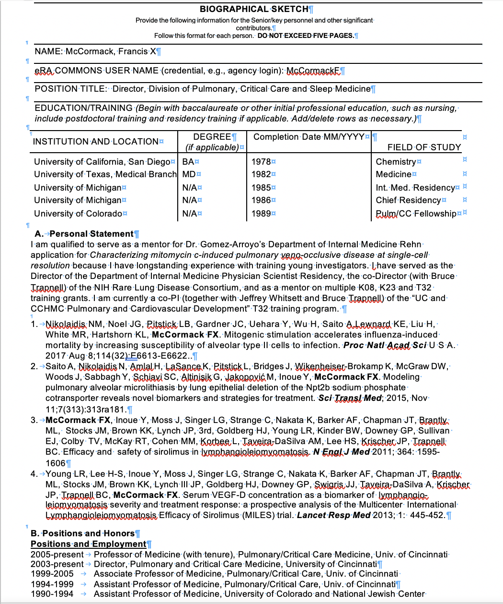
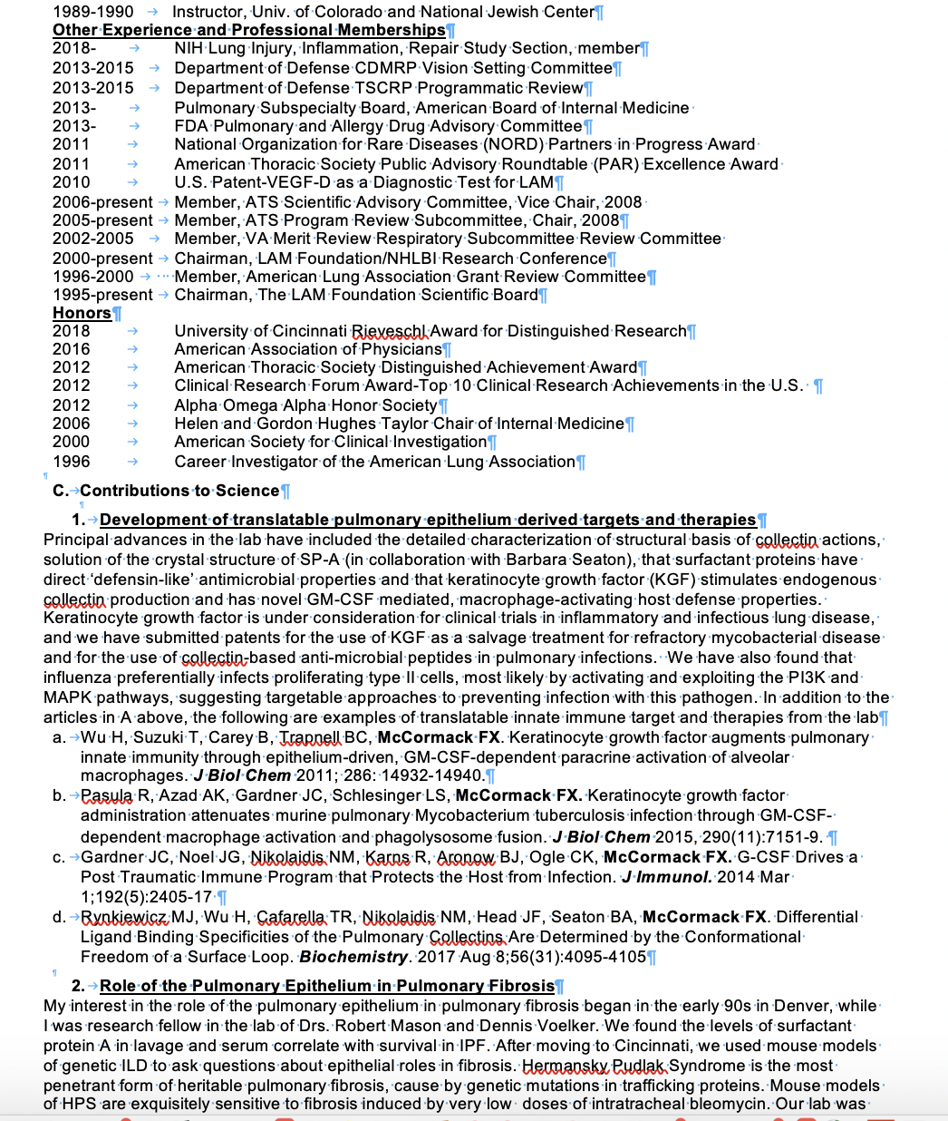
FXM NIH Biosketch

Slide 58
The Budget
Modular vs. Detailed

Slide 59
How are applications scored?
3 reviewers assigned to review in detail; others often only read abstract and aims page
Each assigned reviewer is required to score each of the 5 core review criteria
Each assigned reviewer gives a preliminary overall impact score (not an average or addition)
  Performed prior to the meeting
  Applications are ranked by the overall impact score – only the upper half are discussed
Discussed applications are then assigned a final impact score by each member of the panel and averaged

Slide 60
What do the 1-9 scores mean?
Impact | Score | Descriptor | Additional Guidance
High | 1 | Exceptional | Exceptionally strong with essentially no weaknesses
 | 2 | Outstanding | Extremely strong with negligible weaknesses
 | 3 | Excellent | Very strong with only some minor weaknesses
Medium | 4 | Very Good | Strong but with numerous minor weaknesses
 | 5 | Good | Strong but with at least one moderate weakness
 | 6 | Satisfactory | Some strengths but also some moderate weaknesses
Low | 7 | Fair | Some strengths but with at least one major weakness
 | 8 | Marginal | A few strengths and a few major weaknesses
 | 9 | Poor | Very few strengths and numerous major weaknesses

Slide 61
5 Core Review Criteria
Significance – Addresses an important problem or critical barrier to progress
Investigators – Qualifications of the team
Innovation – Novel concepts or approach
Approach – Feasibility/strength/match of strategy to project aims. Adequate human subjects protections
Environment – Institutional support/resources

Slide 62
Score drivers that are summarized in the Impact Section
Significance
  Is the prior research that serves as key support for the research rigorous?
Investigators
Innovation
Approach
  Have the investigators included plan to address weaknesses in the rigor of prior research?
  Sex as a biological variable
  Include statements regarding rigor of current research (blinding, replicates, statistical approaches)
Enviroment
  Rarely impacts score

Slide 63
Overall Impact determines who gets funded
What is the likelihood of the research to exert a sustained, powerful influence on the research field?
The reviewer writes a paragraph supporting the overall impact score:
  Introduces the general objective of the project in one sentence to orient reader.
  States the level of impact the application is likely to have and why (what is the major contribution/advance to be gained?).
  Identify what the major score-driving factors were
    Significance, Investigators, Innovation, Approach, Environment
  Explain how various criteria in the overall impact score were balanced/combined/weighted

Slide 64
The 12 most common stated or unstated criticisms/flaws that kill a grant
Impact likely to be modest or low
“It’s exploratory/descriptive (“a fishing expedition”)
Aims are inter-dependent—if aim #1 fails, aims 2 and 3 fail
Aims are too ambitious
The cell or animal models chosen are flawed
Aims are too descriptive, not mechanistic
The lab does not have a track record with the techniques proposed
Work is incremental
Directions are not novel
Availability of tissue or research subjects is likely to be limiting
Investigator productivity is lagging or impact of prior work is low
Preliminary data is insufficient
Prior criticisms not adequately addressed
Unwillingness to share reagents
Its rare for environment or resources to be a major factor in grants from a research institution

Slide 65
Grant Writing Tips
Don’t get discouraged, it’s tough for everyone
Don’t take the reviews personally, take them seriously
A well written grant is like currency, it is going to be useful to you even if the targeted grant is not funded
you 'rule' on that topic
you’ve read the literature
you’ve organized your thoughts
it will facilitate future grant submissions and papers

Slide 66
The Reviewers
The program officer distributes grants to reviewers, mindful of conflicts
hopefully the reviewers will be experts in your field, but not always
each reviewer gets assigned 5-10 grants where they need to write reviews (1st, 2nd, or 3rd reviewer)
each reviewer may also get another 2-5 grants that they are readers on
this is a heavy load – in my opinion each grant takes at least eight hours to read, read again, read again and write a coherent, balanced critique
there is incentive to narrow the field by indentifying grants that can be triaged

Slide 67
Reviewers submit their scores
This happens about a week before the study section meets
Reviewers are blind to all scores until all scores are submitted.
This is very important—it facilitates independent thinking and forces people to defend their positions
Reviewers never see scores of conflicted grants
The scores are compiled by the program officer and the grants are ranked.
The program officer makes an preliminary decision about the cut off score for triaging grants

Slide 68
Peer review
Pre-meeting calibration
One week before the meeting, reviewers are able to view each other scores and critiques, and they can modify their own based on issues they may have missed.
This enable reviewers to consider everyone’s perspective and modify their position

Slide 69





































Peer Review
The Study Section Meets
₁st
₂nd ₃rd
readers
the reviewers sit around a table like this for 2 days
all of these people will score your grant after they hear the arguments of the reviewers, but only a few non-reviewers will actually look at it closely

Slide 70
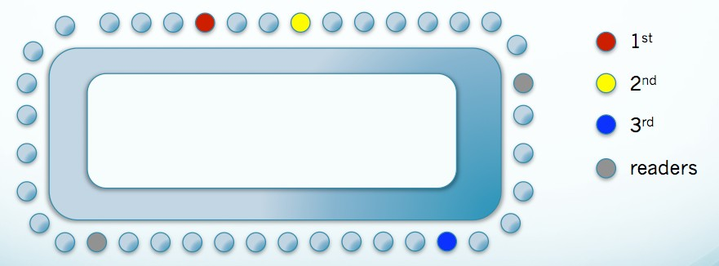
You grant may be triaged/unscored.
The first thing the panel does is review guiding principles
  confidentiality
  no grandstanding
  no lobbying
  no discussion outside of room
  rare disease is welcome
The second thing the panel does is come to consensus about which grants will be triaged
  Usually at least 50% of the grants
  1st and 2nd reviewers are asked if they want to rescue any grants that were below the triage line set by the Program Officer
  If unscored, the reviewers get comments but no percentile rank or summary of discussion (because there was none)

Slide 71
Some observations about peer review and study section dynamics
Most reviewers try their best to be fair and balanced
  they have been in the same boat
  it is probably as fair a process as is possible with human beings involved
The perspective of a good reviewer evolves during the process
  their initial calibration is based on their stack of grants
  recalibration occurs in in premeeting calibration, in study section and post meeting calibration
It is incumbent on reviewers to act responsibly when commenting
  they should have an open mind
  disclose whether they have carefully read the grant
  avoid non-evidence based opinions
  resist human inclinations to dig in and defend one’s original positions
  avoid making redundant comments, ‘showing off’ or campaigning
Study section dynamics often determine the outcome:
  its rare for final score to fall outside the pre-meeting range
  body language plays an important role
  grants rise and fall on the credibility and persuasiveness of champions and fault finders
    and its easier to find fault than to defend

Slide 72
Post Meeting Harmonization
After the meeting, the Program Officers asks all 3 reviewers to reconsider the comments based on the discussion, and to make sure their scores are aligned with your post meeting perspective on the grant

Slide 73
The fundability of the grant is summarized in the Impact section, which is essentially a synthesis of score driving factors from each of the 5 elements
The likelihood that the project will exert a sustainable, powerful influence on the research field involved (i.e.-high, medium or low)

Slide 74
New Investigators:
You are the next generation!
NIH website for new investigators:
http://grants.nih.gov/grants/new_investigators/index.htm
New Investigator: has not previously competed successfully as PD/PI for a substantial NIH independent research award.
New and Early Stage Investigator Policies
  Under this policy, New Investigators within 10years of completing their terminal research degree or medical residency will be designated Early Stage Investigators (ESIs).
  Traditional NIH research grant (R01s) applications from ESIs will be identified and the career stage of the applicant will be considered at the time of review and award.

Slide 75
Tips for the Junior Investigator
Find a MENTOR
Interdisciplinary collaboration is a MUST!
Know the experts in the “niche area” you are investigating
  Begin to develop these relationships today
  Share emails, phone numbers, plan a phone conference
Make sure you are getting Funding Opportunity Announcements (FOA) & Program Announcements (PA)
Seek and build a Research Team early in your career
Don’t underestimate the need for a GREAT statistician!
NEVER write a grant alone – you will burn out early on!

Slide 76
Prepare to revise as you submit
Remember: senior PI’s get grants rejected/unscored
Success often requires multiple submissions
Anticipate criticisms and start work to address them as you submit

Slide 77
Final word: Resilience & Perseverance
Self inventory
  Identify your strengths and capacities
  Identify where you need complementary skills
  What kind of team or mentor do you need
  What are you passionate about?
Balance
  Find ways to refresh and sustain yourself.
  This is a marathon, not a sprint!
Notes:
much like an inoculation gives one the capacity to cope well with future exposure to disease
77

Slide 78
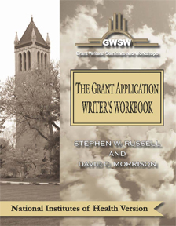

Helpful Resources
http://www.grantcentral.com/workbook_nih_sf424_shortened.html
Instructions for completing an NIH Grant:
http://grants.nih.gov/grants/funding/phs398/phs398.html

Slide 79
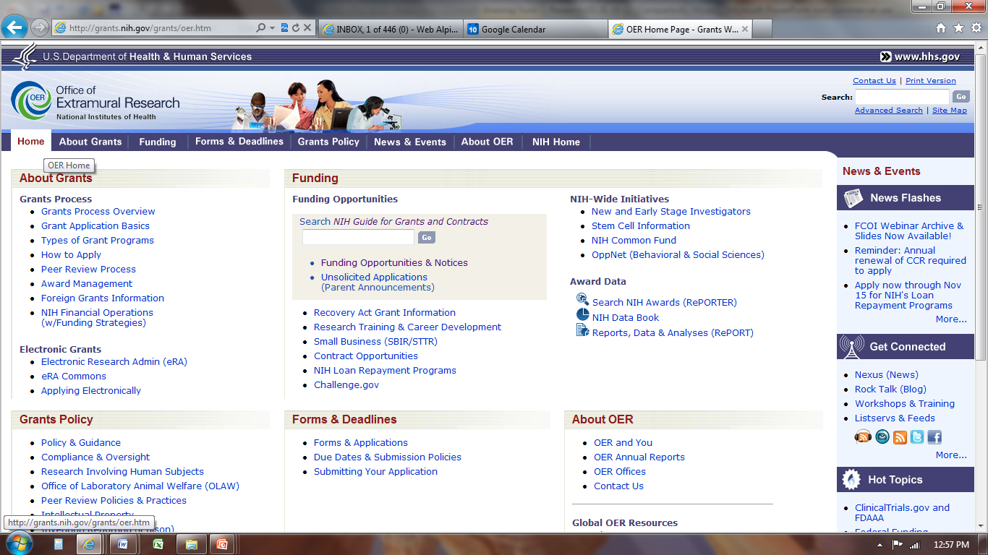
This is a useful website
http://grants.nih.gov/grants/oer.htm

