Slide 1
4 Hour Class Group Workshops

Slide 2
Workshop A

Slide 3
Hazard Identification Exercise
Break into groups of 4-5
Each team will identify the hazards in their photo and present them to the class

Slide 4
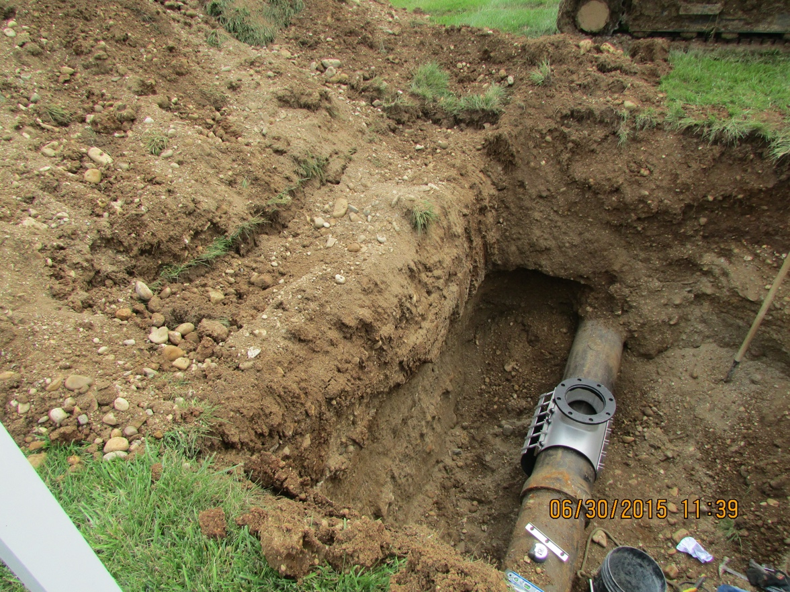
Identify the Hazards

Slide 5
Identify the Hazards
Loose soil/rocks
Potential stability issues
Spoil too close to edge
No Access/Egress

Slide 6
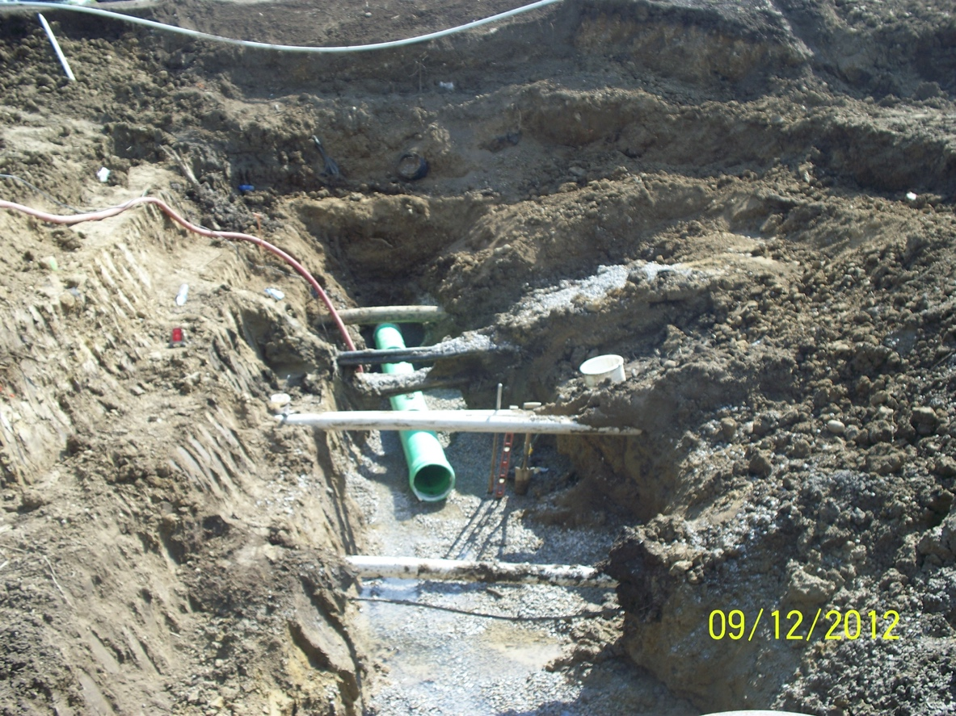
Identify the Hazards

Slide 7
Identify the Hazards
Improper Bench
This has caused the slope to become too shear
Potential Depths of over 20 ft.
Loose soil/rocks
Were utilities marked?
No Access/Egress
The first bench has to be double the height to a max of 4’. So if the bench is 4’ (A) tall the width would have to be 8’ (B)
Water Accumulation

Slide 8
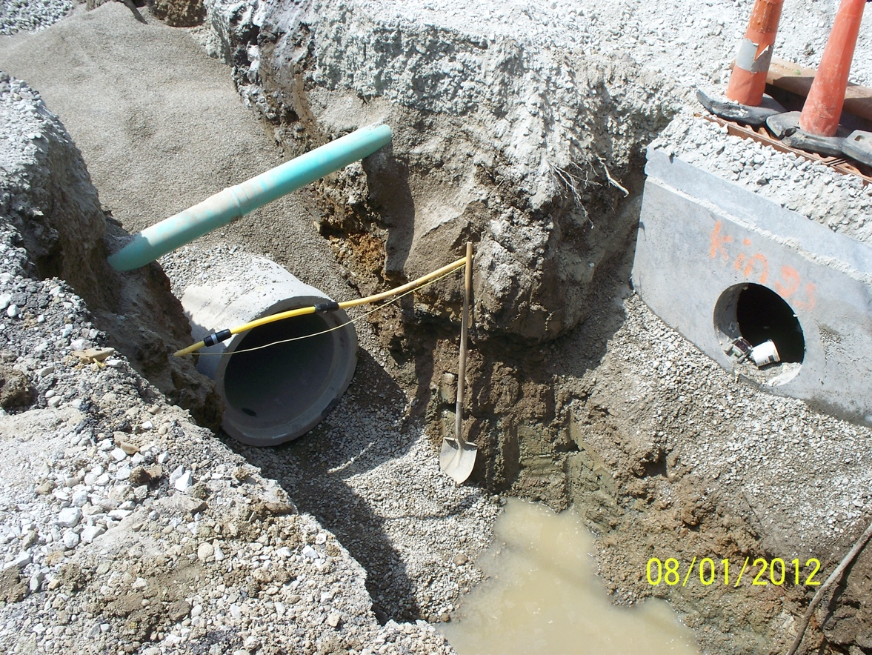
Identify the Hazards

Slide 9
Identify the Hazards
Sidewall is not protected by either a slope, shore, shield, or bench
No Access/Egress
Potential Depths of over 10 + ft.
Were utilities marked?
Loose soil/rocks
Water Accumulation

Slide 10
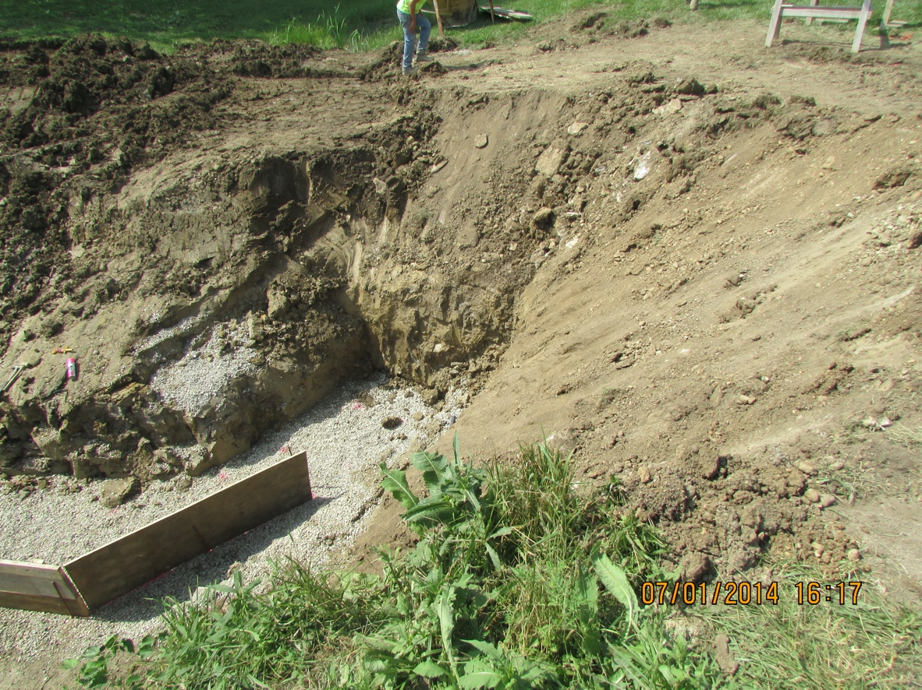
Identify the Hazards

Slide 11
Identify the Hazards
No Access/Egress
Incorrect Slope.
Vertical for 4-5ft, should start at the base
Improper Bench

Slide 12
Workshop B

Slide 13

Soil Testing Exercise
Take 1 play-doh per person
Watch the video below and follow along from minute mark 5:20 to 10:02

Slide 14
Soil Classification Exercise
Review and classify different soil types
Groups of 3-4
Instructor will distribute “soil” jars to each group

Slide 15
Workshop C

Slide 16
Observe “Apparent” Cohesion
Brief, this exercise will only take a few minutes
Take 1 container of beads containing water
Rotate the container to simulate a primary and secondary cave-in failure
Discuss Cohesion

